Slide 1
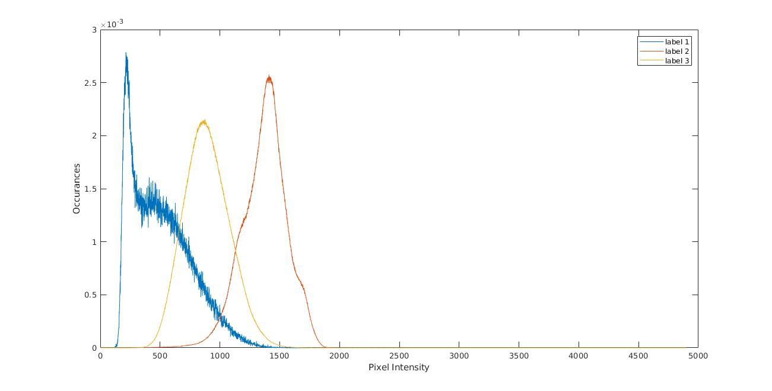
Histogram
Probability of Occurrence of Labels given intensity value

Slide 2
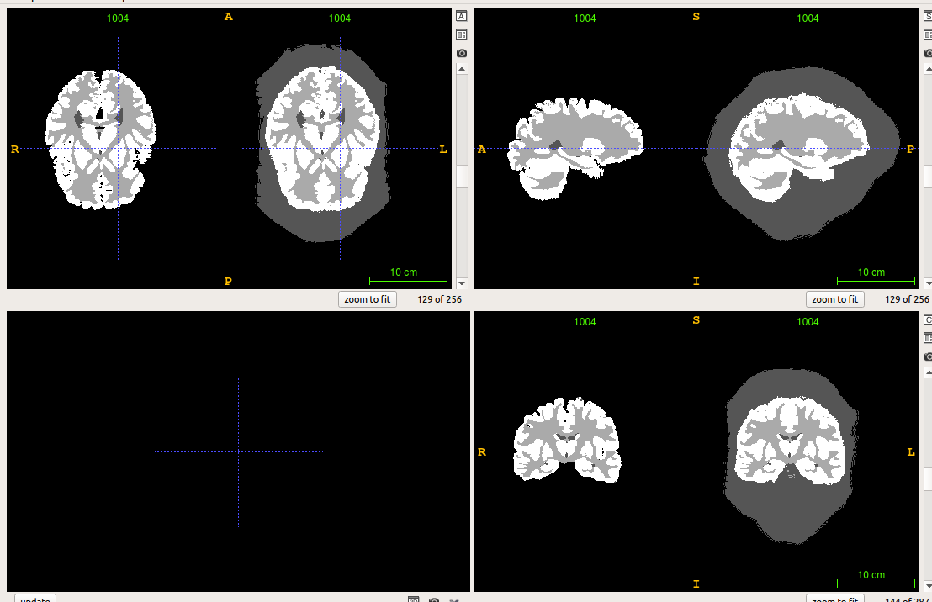
Masking VS Without

Slide 3
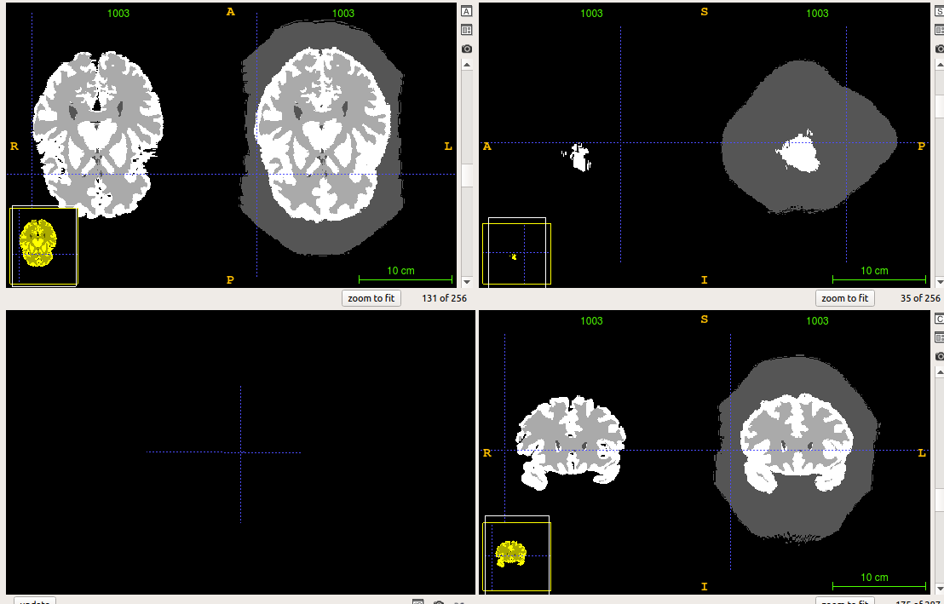
Another Example

Slide 4
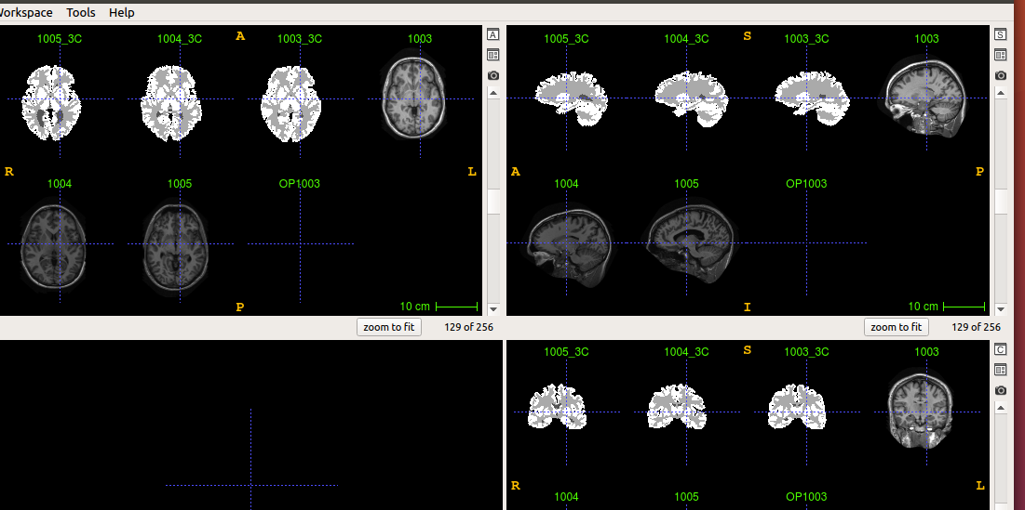
Images and Labels

Slide 5
For Image 1003
 | Label 1 | Label 2 | Label 3
Jaccard | 0.56 | 0.79 | 0.66
Dice | 0.72 | 0.88 | 0.80
False Positive Ratio | 0.35 | 0.24 | 0.11
False Negative Ratio | 0.24 | 0.02 | 0.27

Slide 6
 | Label 1 | 0.18Label 2 | Label 3
Jaccard | 0.63 | 0.85 | 0.73
Dice | 0.77 | 0.92 | 0.85
False Positive Ratio | 0.47 | 0.06 | 0.18
False Negative Ratio | 0.08 | 0.10 | 0.13

Slide 7
 | Label 1 | Label 2 | Label 3
Jaccard | 0.60 | 0.82 | 0.72
Dice | 0.75 | 0.90 | 0.84
False Positive Ratio | 0.23 | 0.11 | 0.20
False Negative Ratio | 0.26 | 0.09 | 0.12

